Slide 1


Population
Trends in
Georgia
Analyzing Population Changes in Georgia Counties as affected by the COVID Epidemic

Slide 2


Outline
Presentation Agenda
Background
Marie Sanon
Analysis
Yi Huang
Jesse Perez
Conclusion
Jesse Perez

Slide 3

Background
Claim - The COVID epidemic has caused a significant shift in Georgia’s counties, trending away from urban and towards rural counties. Since the start of COVID (3/2020), the growth rate of rural counties has exceeded that of urban counties.
Null Hypothesis (H0): Rural Population Growth <= Urban Population Growth
Alternate Hypothesis (HA): Rural Population Growth > Urban Population Growth

Slide 4


Approach
Gather Georgia County census data over last decade to get idea of general trend/pattern.
Randomly select 10 counties for closer analysis
Formulate a growth rate by year and county for analysis
Designate counties as either urban or rural based on population
Plot and analyze patterns across data sets(plots)
Create a heat map to visualize trends(maps)

Slide 5
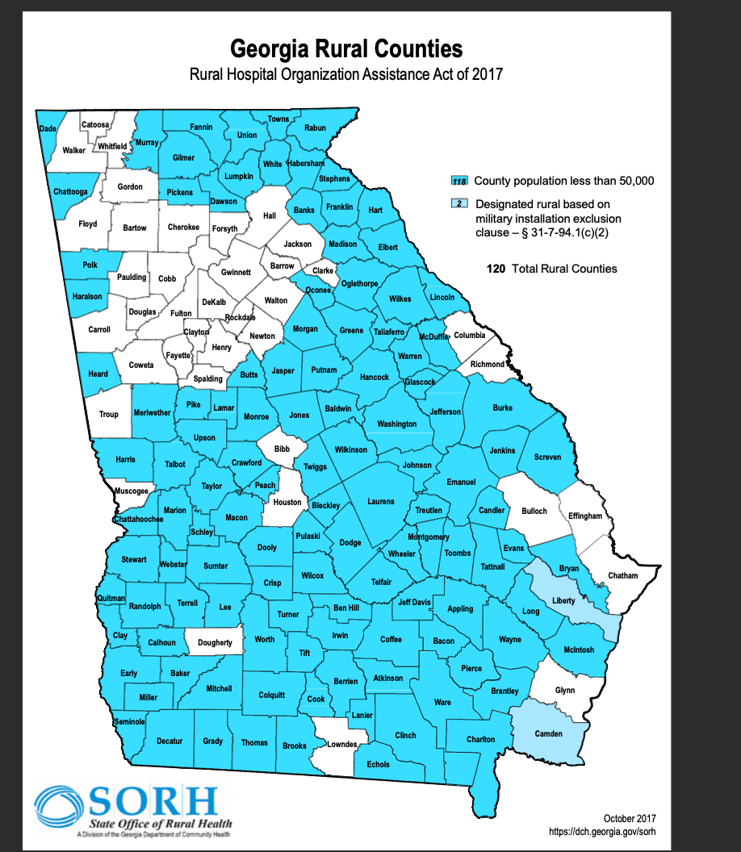
Definition of Terms
Urban v Rural
Georgia’s Department of Community Affairs (DCA) established a population cutoff of 50,000 people to categorize counties as either Rural or Urban
Total Counties = 159
Rural = 120
Urban = 39
COVID Start Date in Georgia
First cases identified March 2020 per GA Department of Health
Notes:
In order to apply science to math, we need to quantify our terms! 2020 will be considered our COVID start year
On March 23, Atlanta mayor Keisha Lance Bottoms signed a 14-day stay-at-home order to direct all city residents to stay at home except for performing essential tasks through April 7.

Slide 6
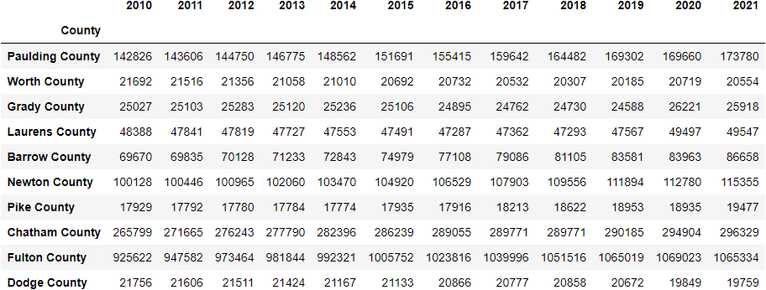
Randomly Selected GA Counties
= Urban Counties
Source: U.S. Census Bureau, Population Division
Notes:
10 randomly selected counties out of 159 counties

Slide 7
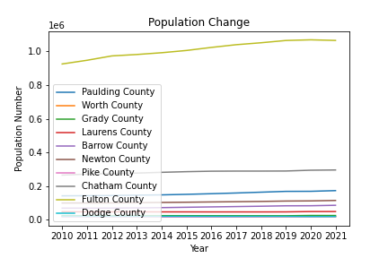
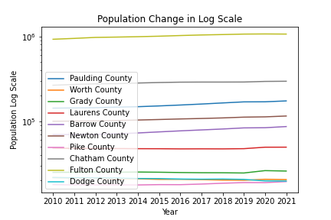
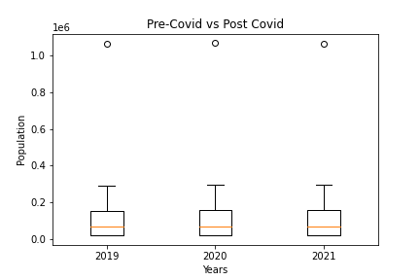
Notes:
here’s what it looks like graphed.

Slide 8
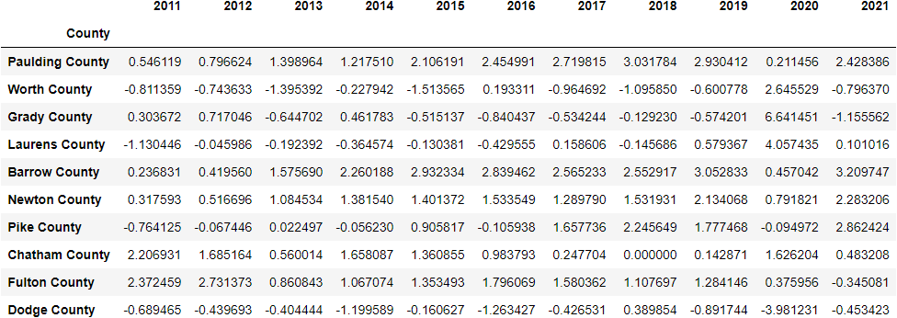

% Change of Randomly Selected GA Counties
Notes:
size isn’t everything. we should look at the relative change from year to year

Slide 9
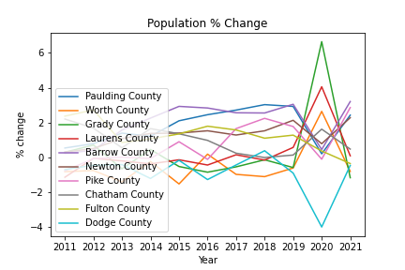
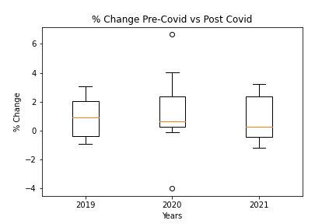
Notes:
here is what that table looks like graphed. bit of a mess…

Slide 10
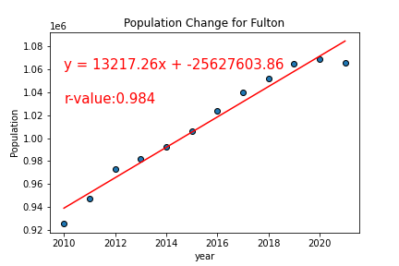
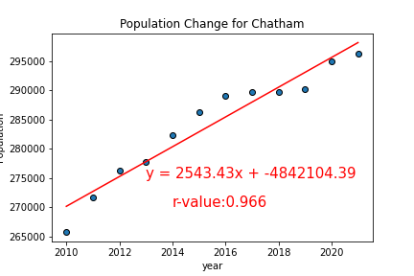
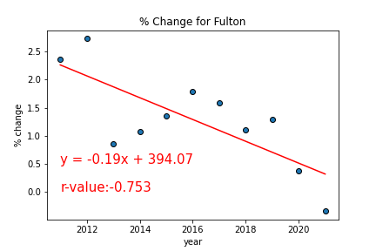
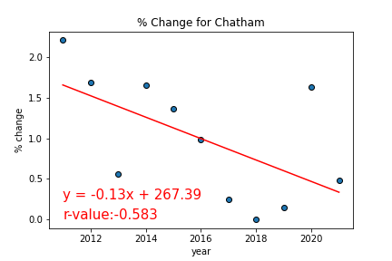
Notes:
very high r-value for pop change. though rate of change is decreasing.

Slide 11
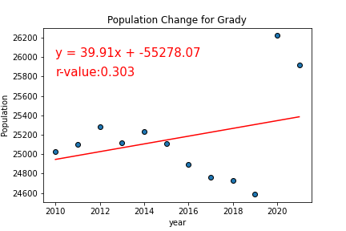
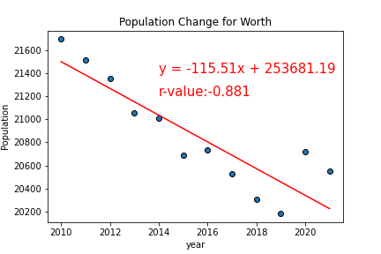
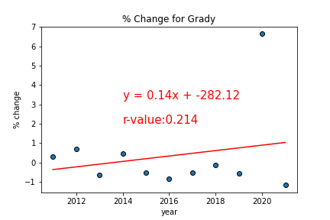
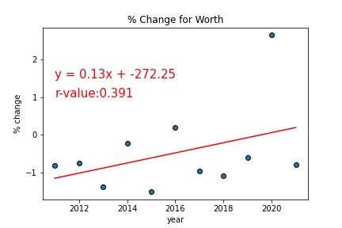
Notes:
again, high r-value. regression for % change isn’t as strong

Slide 12
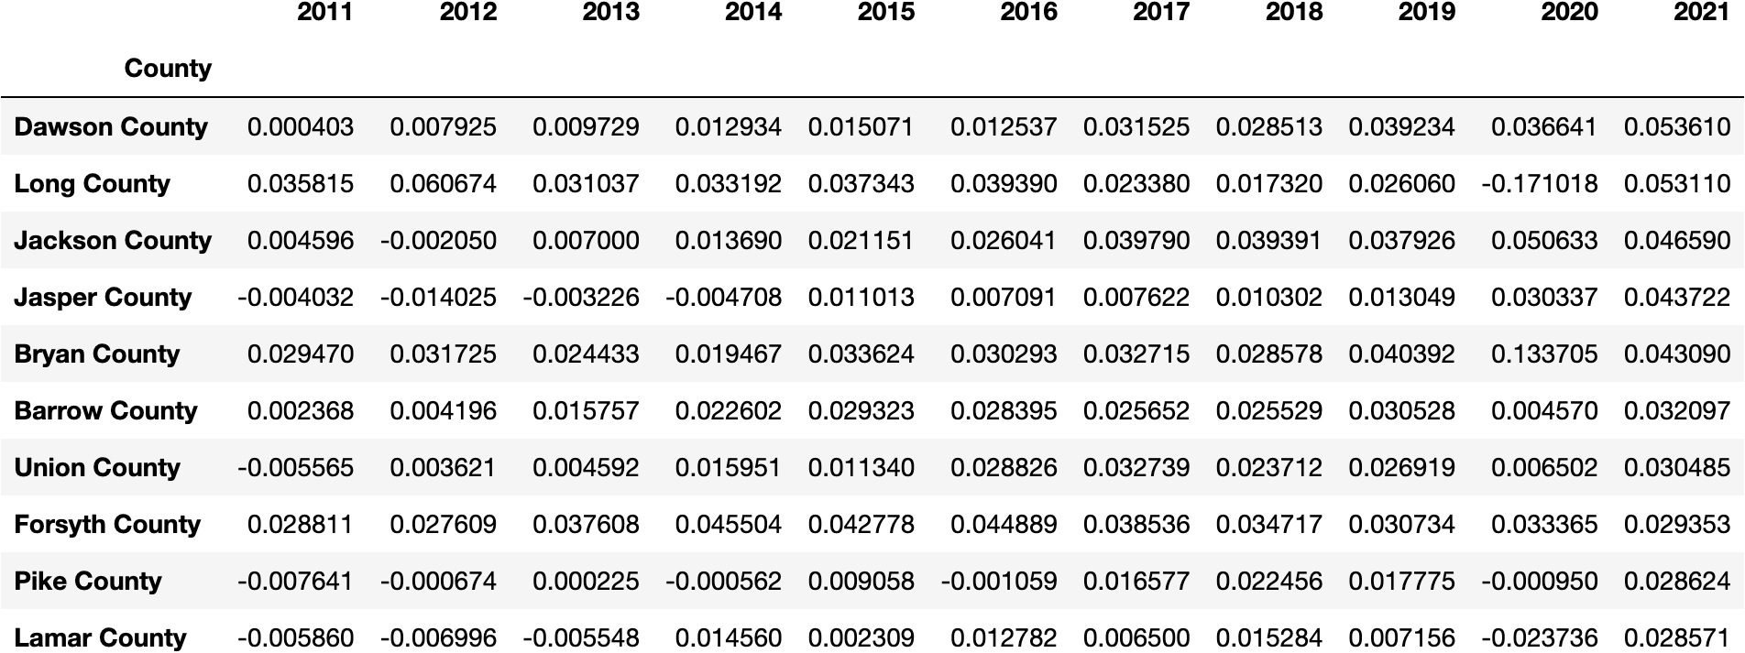
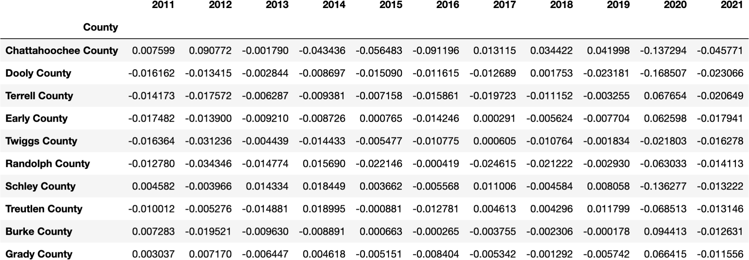
Top VS Bottom Performing Counties
Top 10
Bottom 10

Slide 13
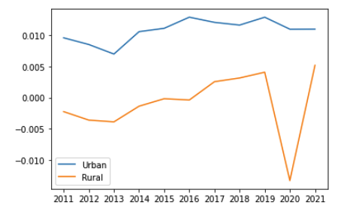
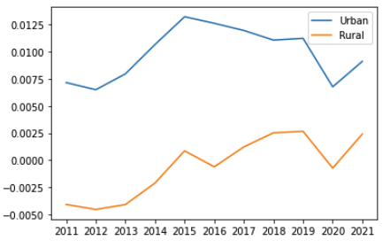
Urban v Rural
Average
Median

Slide 14
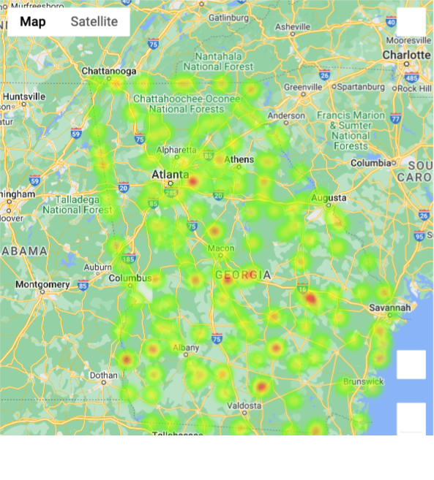
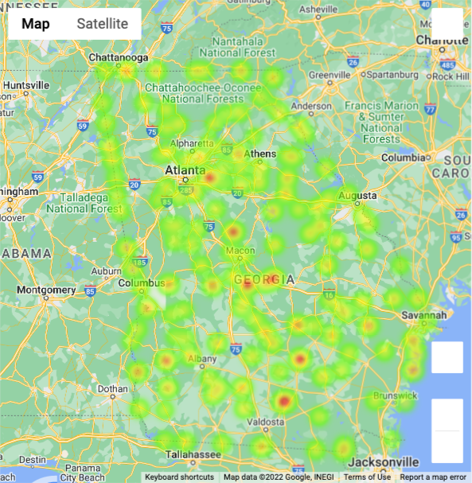
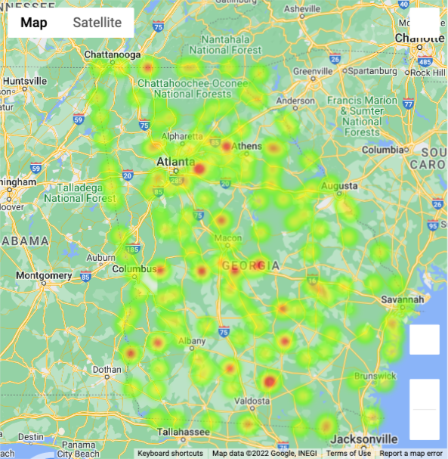
Heatmaps
2019
2020
2021

Slide 15
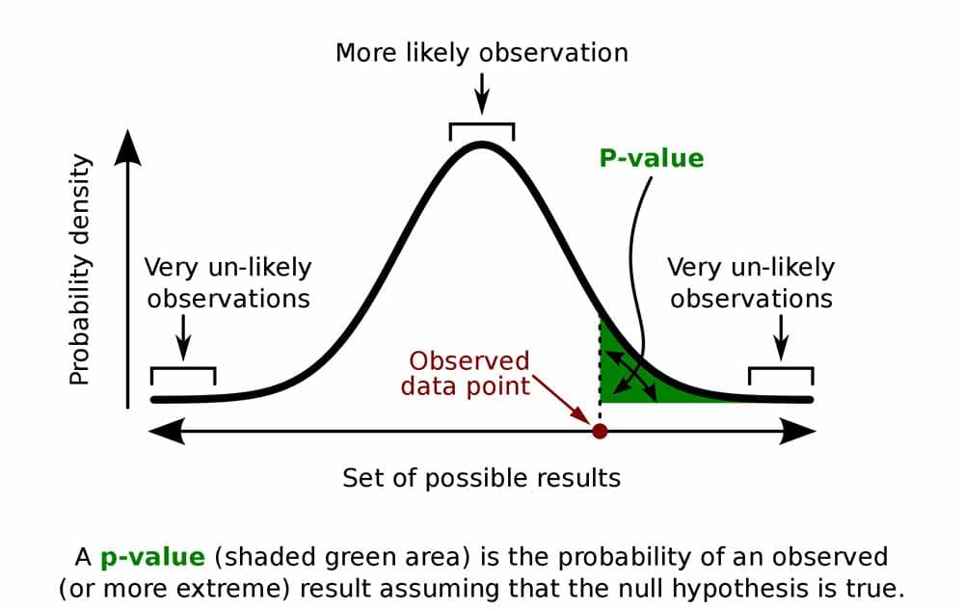
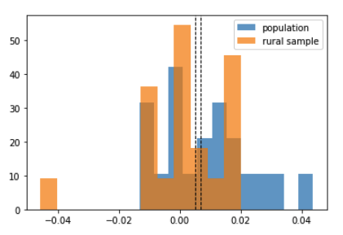
CONCLUSION
Analyzing Rural Population Growth samples against the mean growth rate, we conclude that COVID has not caused a population surge in rural counties.
Our null hypothesis has been accepted and our alternate hypothesis rejected. The growth rate of rural counties did not exceed the average growth rate of Georgia counties in either 2020 or 2021.
Ttest_1sampResult(statistic=-0.41347072821689096, pvalue=0.6889399579094846)
 | 2019 | 2020 | 2021
Rural | 0.41 | -1.33 | 0.52
Urban | 1.29 | 1.10 | 1.10
All | 0.64 | -0.70 | 0.67
image source: simplypsychology.org

Slide 16




Slide 17
Resources
Census Data:
https://www.census.gov/data/tables/time-series/demo/popest/2020s-counties-total.html
Georgia Rural Counties:
https://dch.georgia.gov/document/document/georgia-rural-counties-map/download
Geographical features:
https://eric.clst.org/tech/usgeojson/
Georgia COVID Information:
https://dph.georgia.gov/covid-19-status-report
P.value:
https://www.simplypsychology.org/p-value.html
Additional libraries:
numpy, pandas, random, datetime, matplotlib.pyplot, and scipy.stats (for linear regression – linregress)

Slide 18
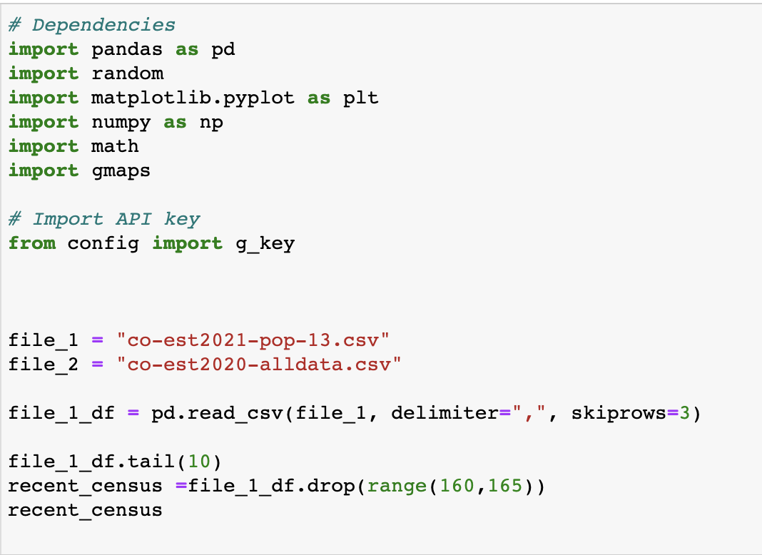
CODE (1) - Dependencies

Slide 19
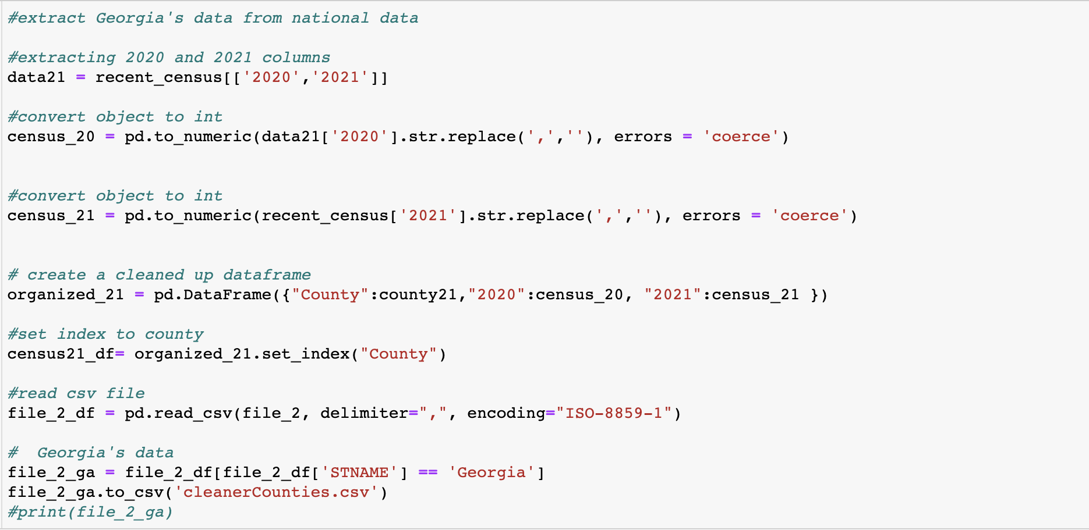
Code (2) - Cleaning our Data, Extracting Georgia Data from Nation

Slide 20
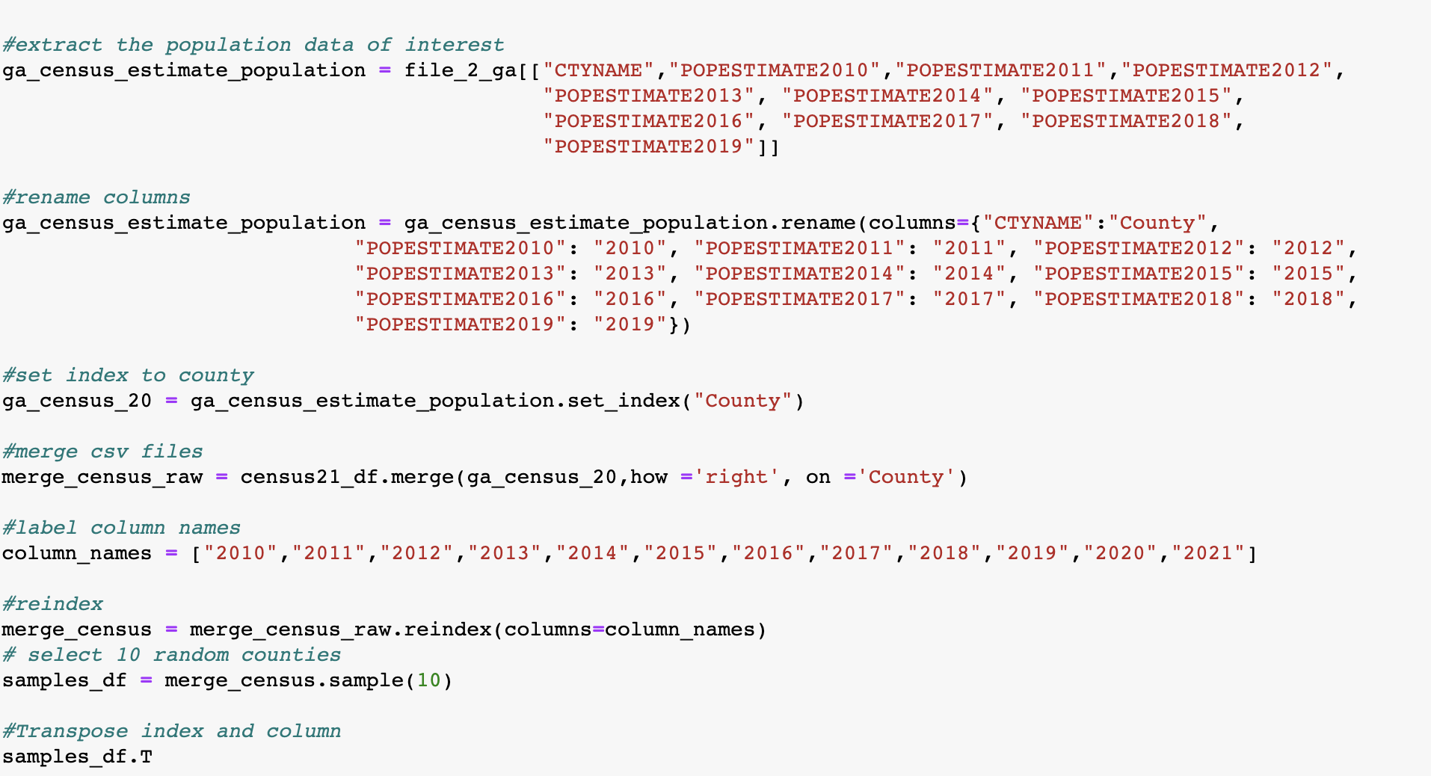
Code (3) - Data Cleaning and Getting Sample

Slide 21
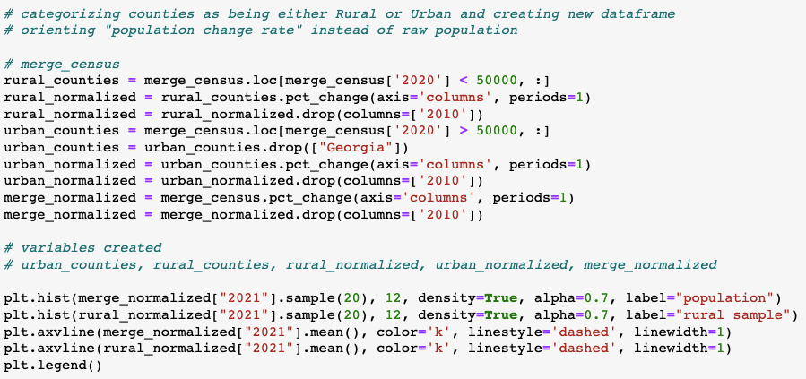
Code (4) -Plotting changes in Population by Counties

Slide 22
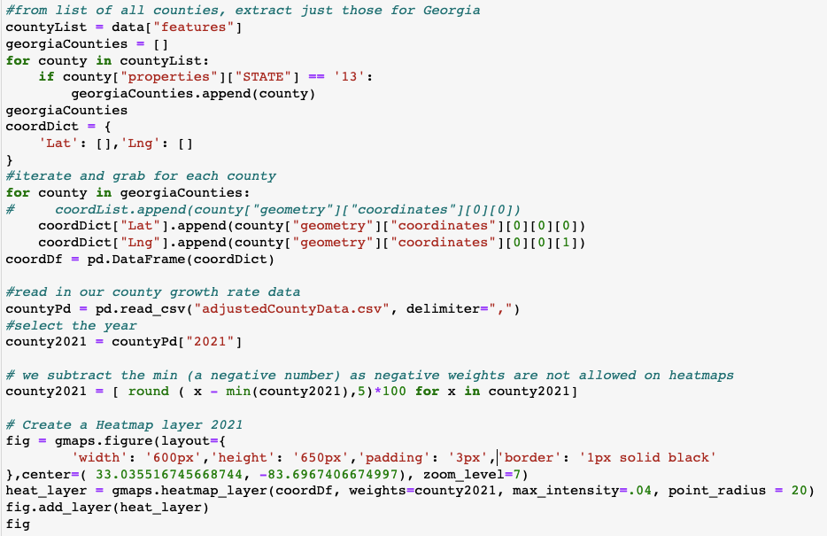
Code (4) - Plotting Growth Rates as Heatmaps

Slide 23
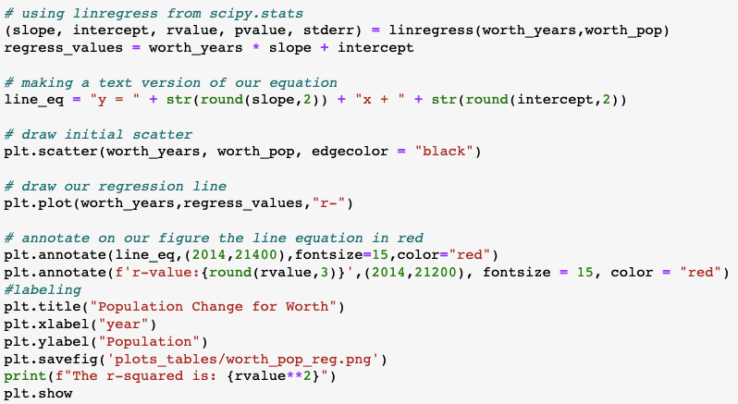
Code (5) - Generating Linear Regression and Plotting

